Slide 1
Galactic Data Representation
Cody Doerr

Slide 2
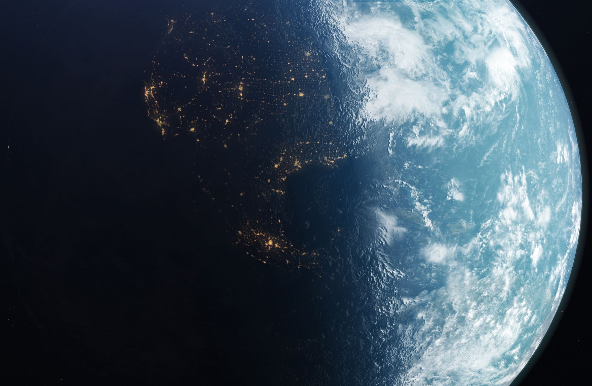
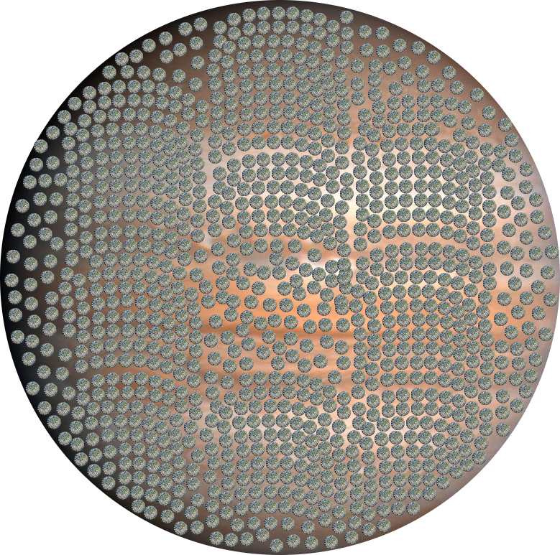
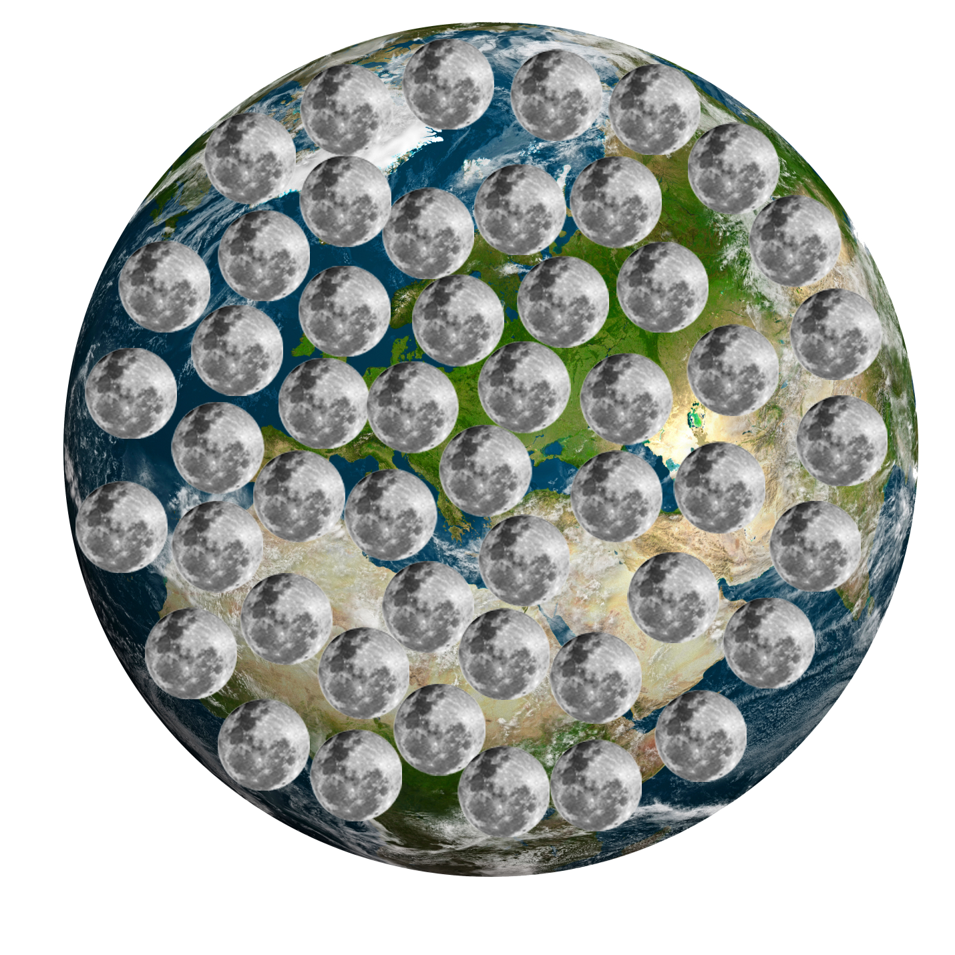
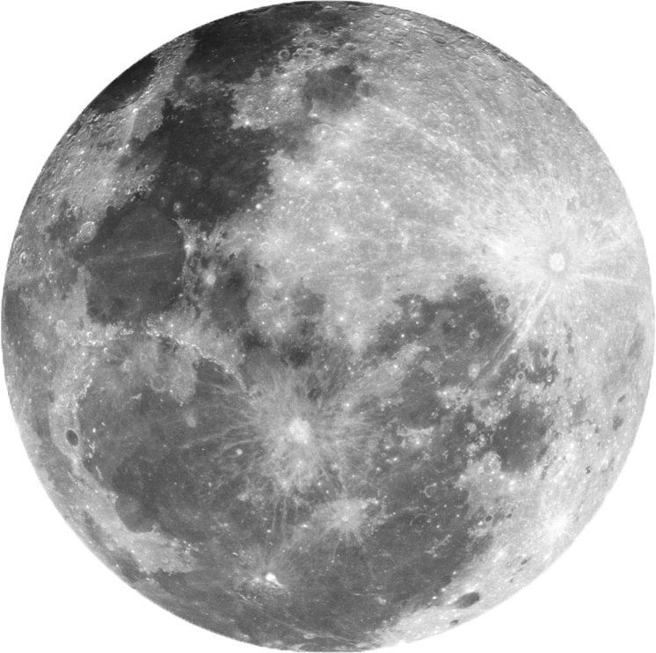
Moon<Earth<Jupiter
Each Moon represents around 20.48 KB of data
Each Earth represents one MB of data.
Jupiter Represents 1 GB of data.

